Slide 1
Trash and Treasure Words
How to Take Notes Without Copying

Slide 2
When we research - think of the article you are using as a pirate’s map. The marking a buried treasure on the map, is the selection of words containing needed information from your article.
= Treasure Words
(Important Words)

Slide 3
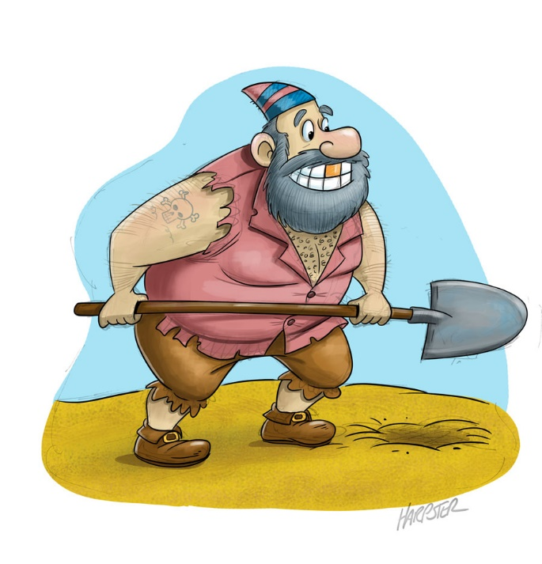
A pirate must dig for the treasure chest, tossing aside
dirt, weeds, and rocks (trash).
A researcher must dig to find words that help answer the questions (treasure words). He or she must
“toss aside”
unnecessary sentences,
phrases, and
words (trash words).
Trash Words

Slide 4
We only want those words we need (treasure).
Treasure words:
They are words from the article that answer the question. They are important words.
Trash words:
Words to ignore.
Unnecessary words to write down such as:
why to their what in the and
Trash Words

Slide 5
Of course these words aren’t really “trash” –and they are still good words, but they DO NOT help answer any questions defined in your research question.
Let’s look at a couple easy examples:
The anteater has a long snout.
Treasure words: long snout
Here is another example and how I would record the treasure words on my note page:
Elephants are herbivores and can spend up to 16 hours days collecting leaves, twigs, bamboo and roots.
Treasure words: herbivores 16 hours day collecting leaves twigs, bamboo, roots

Slide 6
Rules of Note Taking:
Read and become familiar with your research questions.
Read the article or source one sentence at a time.
Stop at the end of the sentence and decide if there are any treasure words.
Use your cursor to select and highlight the treasure word.
Record the treasure words in the appropriate place on your note taking form/paper.
Use bullet or comas to record your treasure word facts
Add some of your own words or change treasure words slightly if needed to make sense later.
Use abbreviations and symbols

Slide 7
Black Bears
Basic Facts:
Black bear fur is usually a uniform color except for a brown muzzle and light markings that sometimes appear on their chests. Eastern populations are usually black in color while western populations often show brown, cinnamon, and blond coloration in addition to black. Black bears with white-bluish fur are known as Kermode (glacier) bears.
Diet:
American black bears are omnivorous: plants, fruits, nuts, insects, honey, salmon, small mammals and carrion.
My Notes:
Black Bear Facts::
Brown muzzle, light markings on chest
Easter bears black & western: brown, cinnamon, blonde, black
White fur – Kermode (glacier)
Omnivor: eats plants, fruit, nuts, insects, honey, salmon, small mammals, carrion.
Diet::

Slide 8
3 Important Things to Remember
1) What are “treasure” words?
Important words I need for my research.
2) What are “trash” words?
Words I DO NOT need for my research
3) How to I take Notes? I read each sentence and stop to see if I found a treasure word.
Record it for understanding later.

Slide 9
Have fun researching your animal and go find your treasure words!

