Slide 1
Research
The World Wide Web is a great place to find more information about a topic. But there are a lot of sites out there—some are good and some are not so good. Can you track down good sites for a research topic? Here are some steps to help you use the Web to do research.

Slide 2
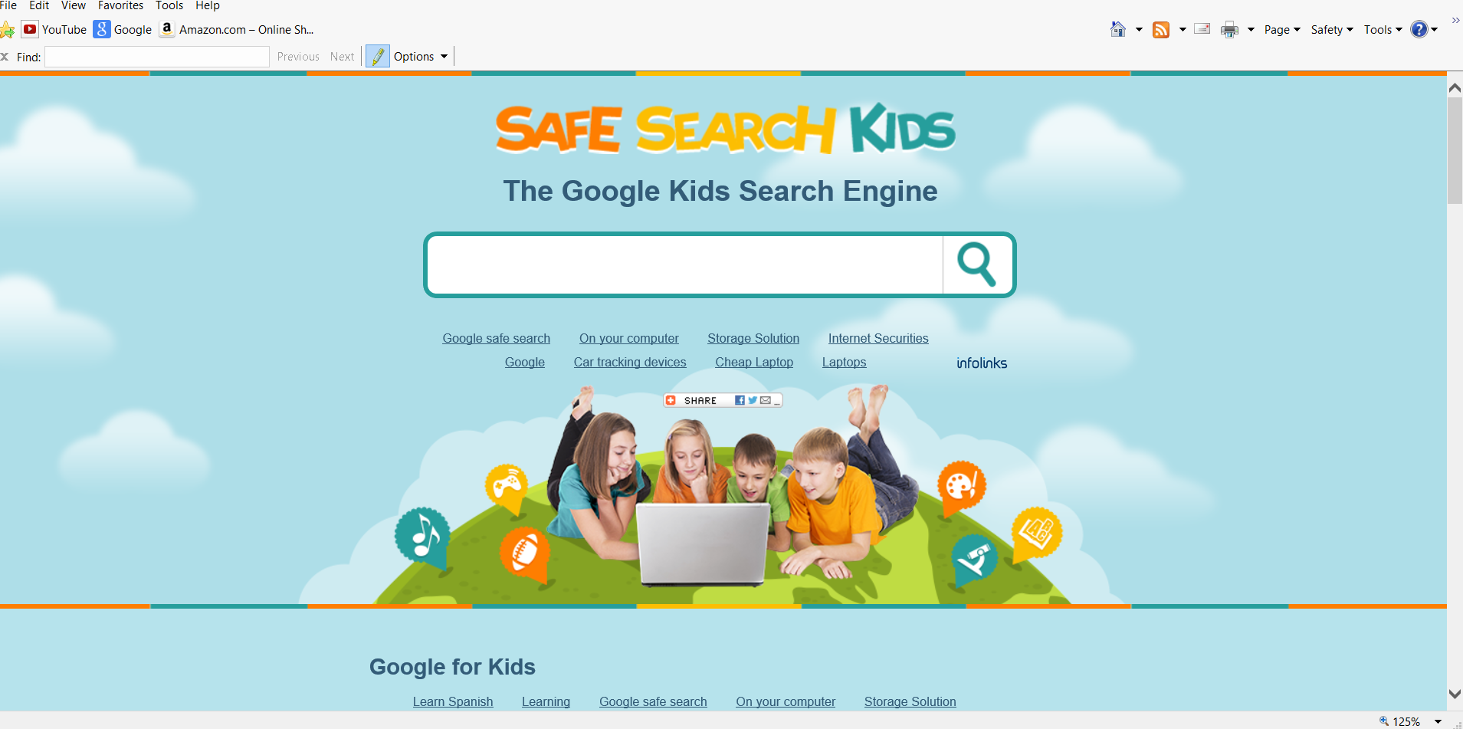
Step 1: To find Web sites on a specific topic, use a search engine, or search site. A search engine helps you to find other Web sites. This is a search engine that was created especially for kids.

Slide 3
 | Step 2: Entering Key Words
 | A search engine works like a library catalog. You type a key word or words to describe your topic. When entering key words, be as specific as possible, so that you don't get too many sites. For example, if you wanted to learn about the first American President, you should type "George Washington" instead of typing "Washington." Otherwise you might end up with a list of sites about Washington, D.C., or the state of Washington. You will type your key words into the empty box next to the word "search."

Slide 4
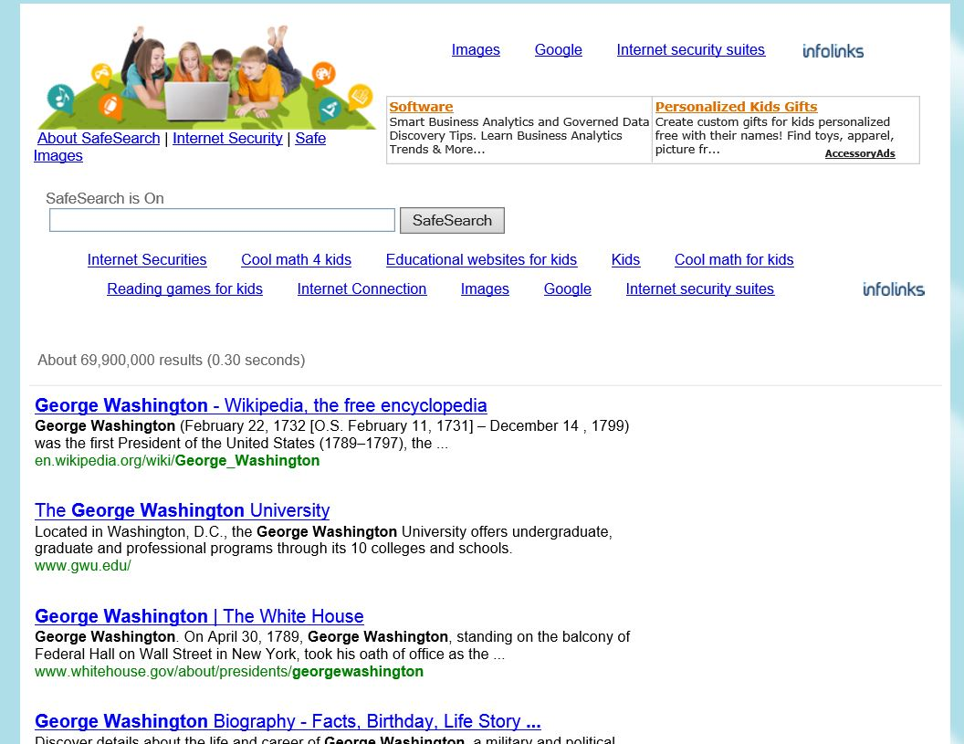
Step 3: Reading Descriptions of Sites:
The search engine will then search the Web and show you a list of sites that contain information that matches your key words. Search engines usually give descriptions of the sites they list. You should read the descriptions to find which site best matches your topic. This is the kind of list, with descriptions, that a search engine will show you.

Slide 5
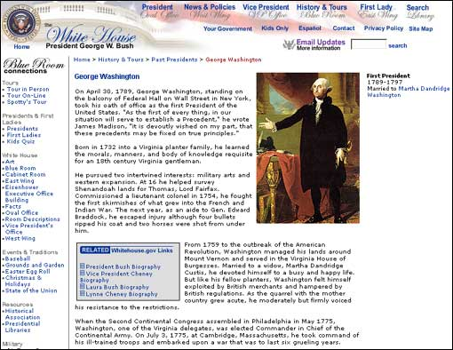
Step 4:
Choosing the Best Web Site
When you read a description of a Web site that sounds useful, click on the name of the site. That Web site will automatically appear on your computer screen. You can then read what is there to see if it has the information you are looking for. Sometimes you need to look at several sites before you find the one that is best for your research.
Here is a site that might be useful for a report on George Washington.

Slide 6
Here is your topic for todays research:
What happened to all the honeybees?
First we need to figure out what our keywords are going to be.
Keywords: the most important words related to a subject, which you type into a search engine to find the
information you want.
Keywords need to be clear and precise. You can use synonyms and/or alternate words.

Slide 7
Let’s look at the sentence and identify some keywords:
What happened to all the honeybees.
These words seem to be the most important.
Let’s start with just one key word and see what we find:
bees

Slide 8
Now we know about bees, but it still doesn’t answer our research question. How can we be more precise? Can we add another key word or use to key words to find better information?
Let’s look up honeybees!
honeybees

Slide 9
Great job, if you have time, see if you can add another word to be more precise. What word would you add?
Now it’s your turn.

