Slide 1
Research Lesson 1
URLs & Hyperlinks
How to access the
World Wide Web

Slide 2
Internet vs. World Wide Web
We can access the World Wide Web by using the internet. They are not the same thing.
Using the internet allows us to connect to other servers so we can share information. We can use the internet to:
Email
Conference/skype
Most importantly –access the World Wide Web

Slide 3
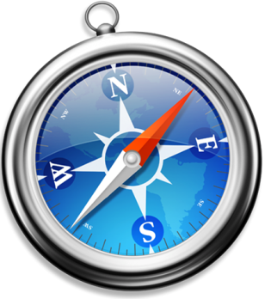
The World Wide Web is a BIG virtual city that uses browsers to translate information so we can view it:
Google Chrome
Mozilla Firefox
Internet Explorer
Safari

Slide 4
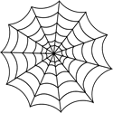
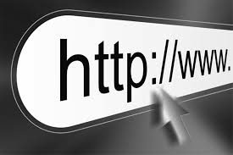
What is a Web Address or a
URL (Universal Resource Locator)
Web Address = URL
Examples of Web Address/URLs:

Slide 5
Hyperlinks:
How do you move around the World Wide Web?
The pages on the WWW are all linked so that you can move around them.
http://urbanext.illinois.edu/

Slide 6
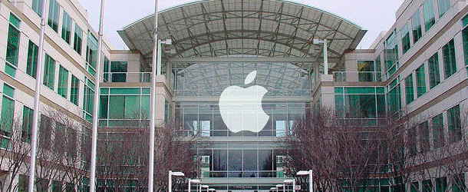
What can we learn about looking closely
at URLs or domains.
Domain Extensions…
Who created the website?
.com- Businesses and Companies
.edu- Educational Institutions
.gov- Government Agencies
.org- Organizations
.net - organizations involved in networking

