Slide 1
Digital citizenship
By mrs. derita

Slide 2
Digital Communication
The digital exchange of information

Slide 3
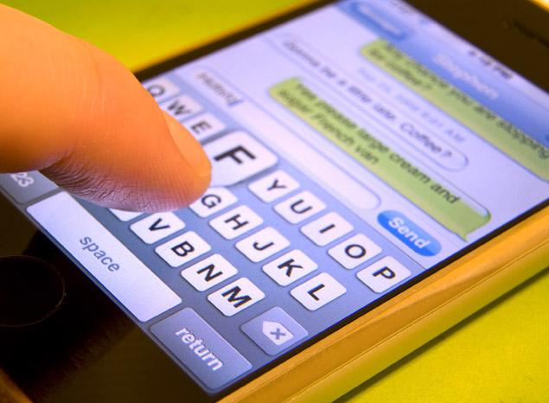
Ways we communicate digitally
Texting and Instant Messaging

Slide 4
Ways we communicate digitally
Email

Slide 5
Ways we communicate digitally
Social Media

Slide 6
Ways we communicate digitally
Video Chat

Slide 7
Digital Communication
Benefits
It’s fast
You can meet new people
You can learn about other places and people
You can share your knowledge and creations
Remember
Don’t share any personal information
EVERYTHING is public
You still need to use manners and grammar

Slide 8
When you’re online remember to… THINK
T – is it true?
H – is it helpful?
I – is it inspiring?
N – is it nice?
K – is it kind?

Slide 9
Digital Security
Electronic precautions to ensure safety

Slide 10
Password Tips
Don’t give passwords to others
If you have passwords written down, keep that safe (maybe in a journal or in your planner)
Never give out your password in an email, even if someone asks for it
When you create a password make sure it has:
At least one capital letter
At least one number

Slide 11
Keeping yourself safe online
No one should ask for your personal information in an email, if they do show an adult you trust right away
When you use a public computer (at school, at the library, etc.) make sure to uncheck the “remember me” box or click “public computer”
Make sure to log off of all of your accounts when you are using a public computer

Slide 12
Digital Etiquette
Electronic standards of conduct or procedure

Slide 13
Etiquette means…
The dictionary says, “the rules for the proper way to behave.”
This means how we should speak and act.
When we are on online a lot of the rules are the same as they are when we are face to face.
There are some specific rules you should know.

Slide 14
Digital Etiquette
Social Media
Email
Do not tag people in posts or pictures without permission
THINK before you post any comments
Do not use ALL CAPS ALL THE TIME, it’s like YELLING!
Write a short description in the subject line
Start with a greeting, it’s like a letter
End the email with your name
Don’t use ALL CAPS

Slide 15
7 Rules for Digital Etiquette
Choose screen names and email addresses wisely,
Do not use your whole name, but make it something you can remember and wouldn’t be embarrassed to share with adults.
2. Double check before you hit “send”
Make sure nothing you wrote could be misunderstood. Remember the reader cannot hear the tone of your voice, they might not know if you were joking.
3. Take the high road (but don’t brag about it)
If a comment thread or chat are getting negative, sign off, or stop commenting on it. No good will come from firing off (sending) a nasty comment.
4. Grammar rules
If you are just texting or messaging with a friend, then periods and capital letters aren’t required. If you are commenting on a discussion for class or sending an email to a family member, you need to use the same grammar as when you write in school.

Slide 16
7 Rules for Digital Etiquette Continued
5. Keep a secret
Texts, posts, comments, and emails can all be captured or copied and sent to other people. If you think something might embarrass someone, get them in trouble or cause drama in any way, keep it to yourself, or better yet, delete it.
6. Don’t hide
You shouldn’t share your personal information online, but you also shouldn’t pretend to be someone you’re not. Only post things you would be proud to say out loud.
7. Follow the Golden Rule
Treat others as you would like to be treated! “Text unto others as you would have them text unto you.” Remember to THINK before you post, text, email or comment.

