Slide 1
5th Grade
Internet Research
Part 2

Slide 2
Last week we discussed 7 steps of research:
Identify research topic/theme
2) Narrow it down (focus)
3) Create a research/essential question.
Pull out KEY WORDS
5) Enter your key words into search engine
6) Evaluate results page
7) Chose a reliable source/best web site
Today we will add on two more steps
to our research Process!

Slide 3
My teacher gave me an assignment to do a research paper on severe weather.
Topic: Severe Weather
2) Focus: Lightning
3) Create a research/essential question.
How hot is lightning?
5) Key Words: lightning temperature
6) Once I had my key words, I typed them into my search engine and came up with my results page and I
EVALUATED THE SITES
7) Finally I found a great website to use as my reliable source!
http://news.discovery.com/earth/is-lightning-hotter-than-the-sun.htm

Slide 4
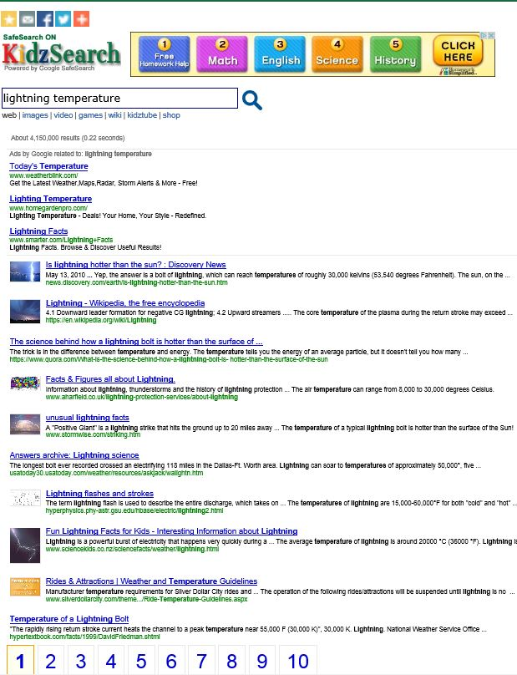
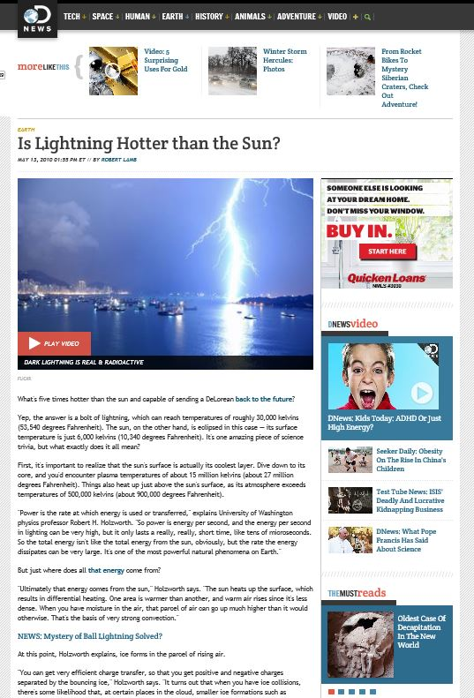
I read the short descriptions and the first article turned out to be a great one thanks to my precise Key Words!
Evaluate Results Page
Select a Website/Reliable Source

Slide 5
Step 8: Taking Notes
Once you have found your reliable source and you begin your research, you will need to keep notes on the information and facts you find. You will need to read or skim the article to look for facts to complete your research. Make sure you just don’t copy all the sentences from the article, but instead just jot down the facts that you need. Your research doesn’t need to be in complete sentences. Sometimes I use bullets to write down the facts I’m recording:
Bolt of lighting-reach temp. of 50,000 degrees
5 times hotter than sun

Slide 6
Plagiarism
But before we go any further, we should talk about something called Plagiarism.
Plagiarism is stealing.
If you go to someone’s house and take his or her iPod without asking and pretend that it is yours, that is stealing.
Reading a book or an internet article, copying the words from it, and pretending they are your original thoughts is also stealing.

Slide 7
Plagiarism
Plagiarism is against the law.
UCLA Law has compiled a list of lawsuits filed over the last 100 years for plagiarism in the music industry alone at this website: http://cip.law.ucla.edu/song.html
College students have been expelled from school for plagiarism.
Students caught plagiarizing, at the very least, fail their assignments.

Slide 8
How to Avoid Plagiarism
To avoid plagiarism, give credit to the source of your information. In other words,
CITE YOUR SOURCE!!!
Here is how we do that:
From the website you are using to record all your research, write down:
Last name, first name of author, name of the article (in quotations), name of website, and the date you accessed it.

Slide 9
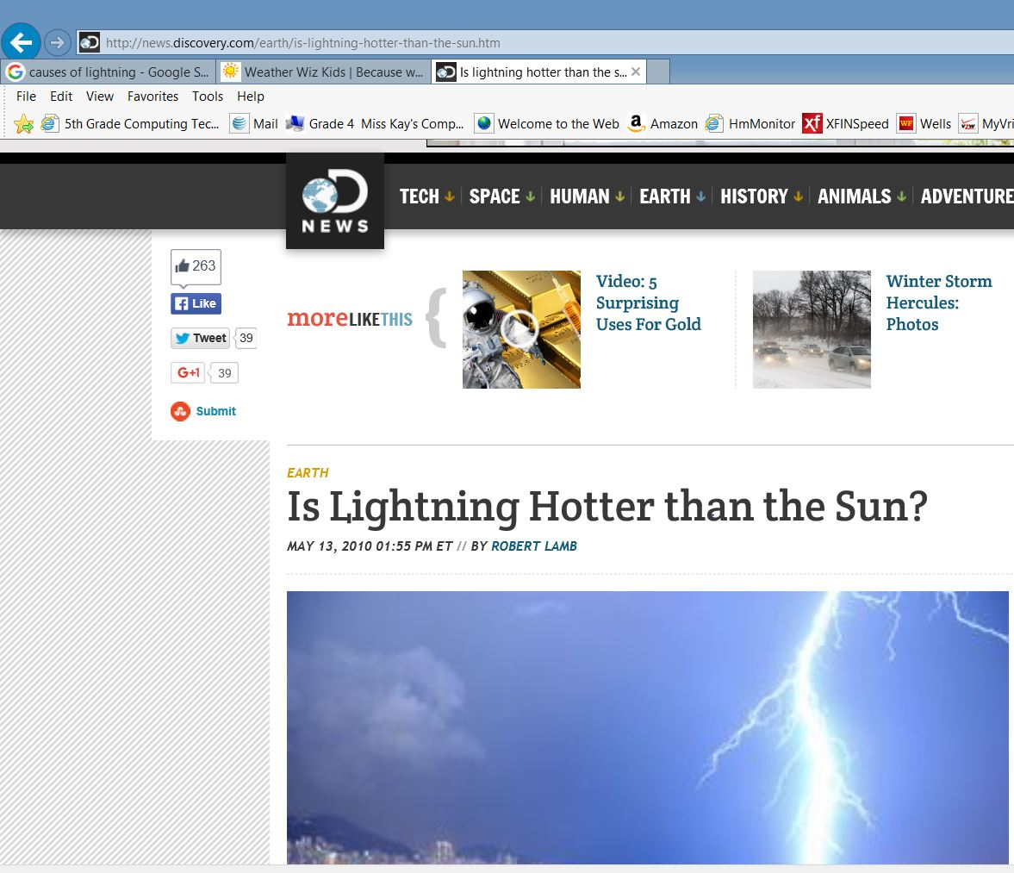
Step 9: Cite Your Source: Here’s What it Looks Like!
Lamb, Robert, “Is Lightning Hotter Than the Sun?”, Discovery News, September 18, 2015
URL Address usually includes website name
Name of Website
“Discovery News”
Article Name/Title
Article Author

Slide 10
Remember How to Cite Your Source:
Last name, first name of author
name of the article (in quotations)
name of website
the date you accessed the article
* Separated by comas! If you can’t find the authors name, leave it out. See example below:
Lamb, Robert, “Is Lightning Hotter Than the Sun?”, Discovery News, September 18, 2015

Slide 11
Now Let’s Practice adding Steps 8 & 9
1) Research Topic
2) Narrow it down (focus):
3) Question.
KEY WORDS:
5) Enter key words into search engine
6) Evaluate Sites
7) Chose a reliable source.
Take notes – Write down 2 facts
Site your Source!

Slide 12
Now Try it On Your Own!
1) Research Topic
2) Narrow it down (focus):
3) Question.
KEY WORDS:
5) Enter key words into search engine
6) Evaluate Sites
7) Chose a reliable source.
Take notes – Write down 2 facts
Site your Source!

